Slide 1
INFO 7374 IMAGENET CLASSIFICATION

Slide 2
SIMPLE MODEL
The ImageNet project is a large visual database designed for use in visual object recognition software research.
More than 14 million images have been hand-annotated by the project to indicate what objects are pictured and in at least one million of the images, bounding boxes are also provided.
ImageNet contains more than 20,000 categories with a typical category, such as "balloon" or "strawberry", consisting of several hundred images.

Slide 3
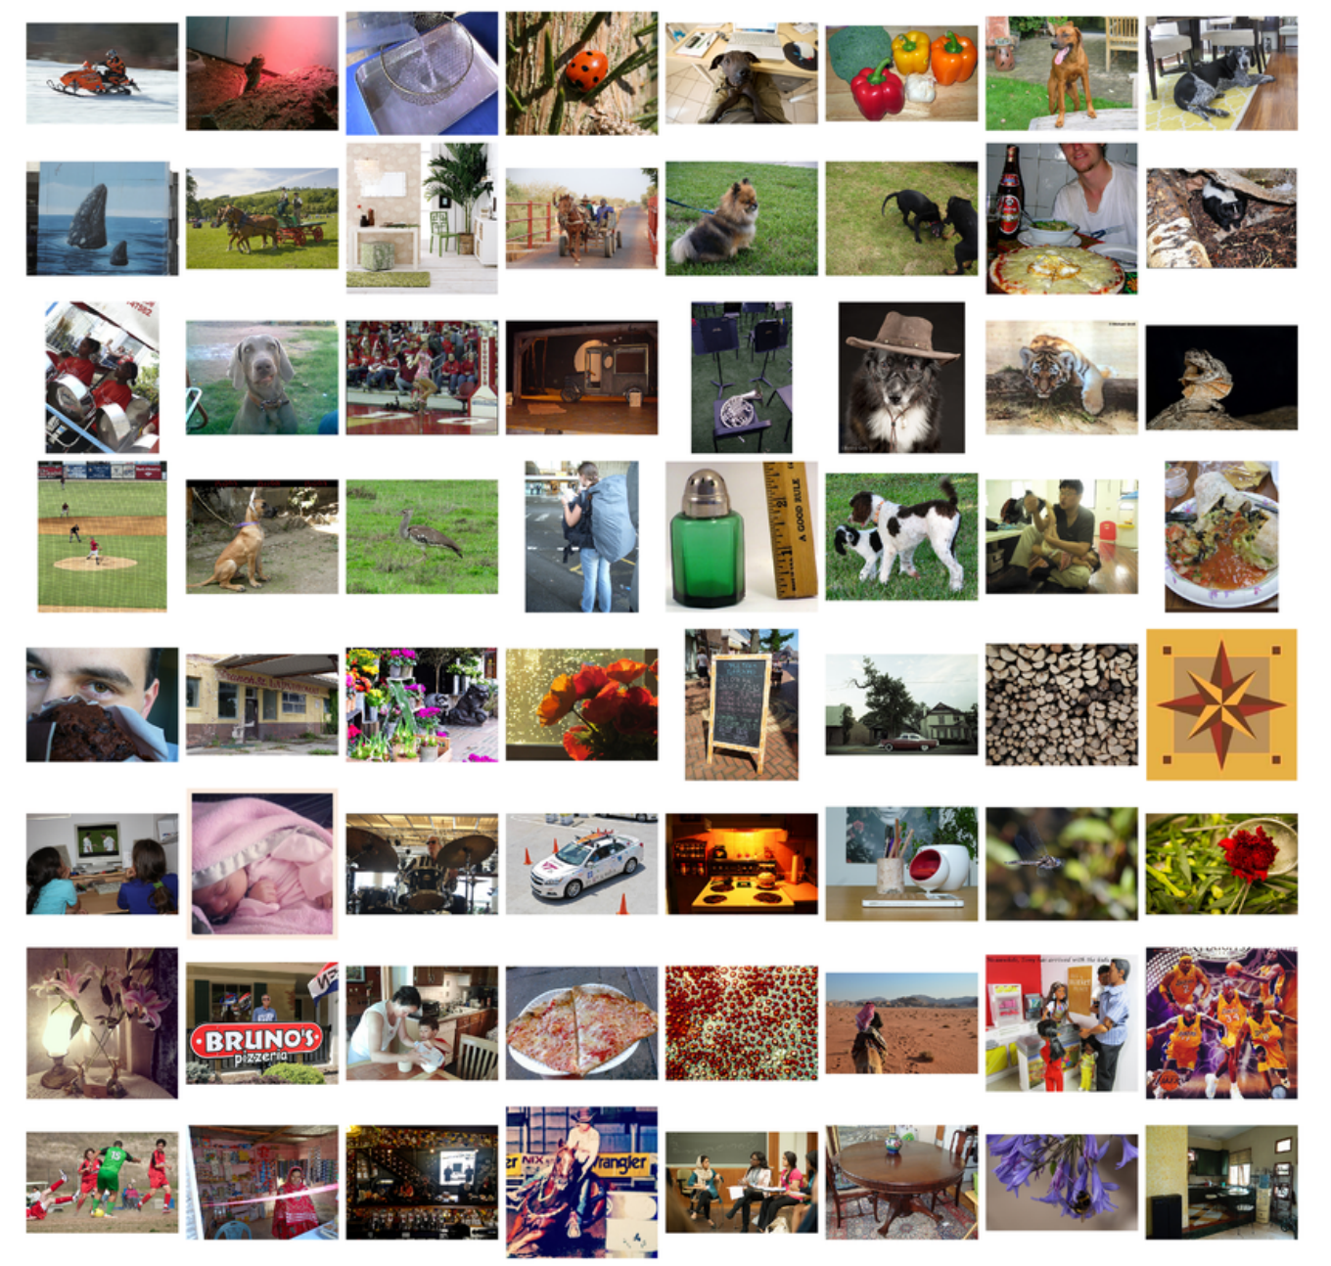

Slide 4
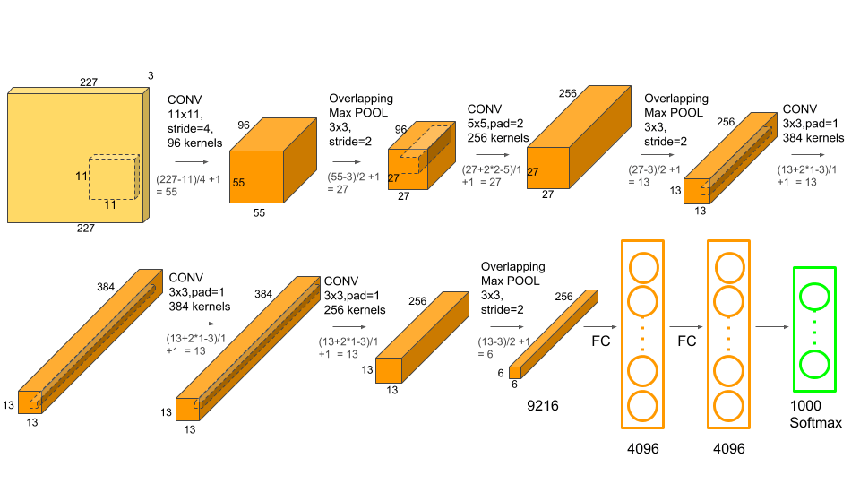
ALEXNET

Slide 5
AUTO KERAS
Autokeras is a automated open source ML tool which help deep-learning researcher mainly for (2D) Image classification.
It is the only thing that is implemented so far and it is missing on many things to be implemented which includes 3D Convolutional Neural Networks, 1D Convolutional Neural Networks, RNNs for speech recognition, normal regression / classifiers RNNs for text, Parallel model training and evaluation Proper memory management; current memory problems cause by PyTorch

Slide 6
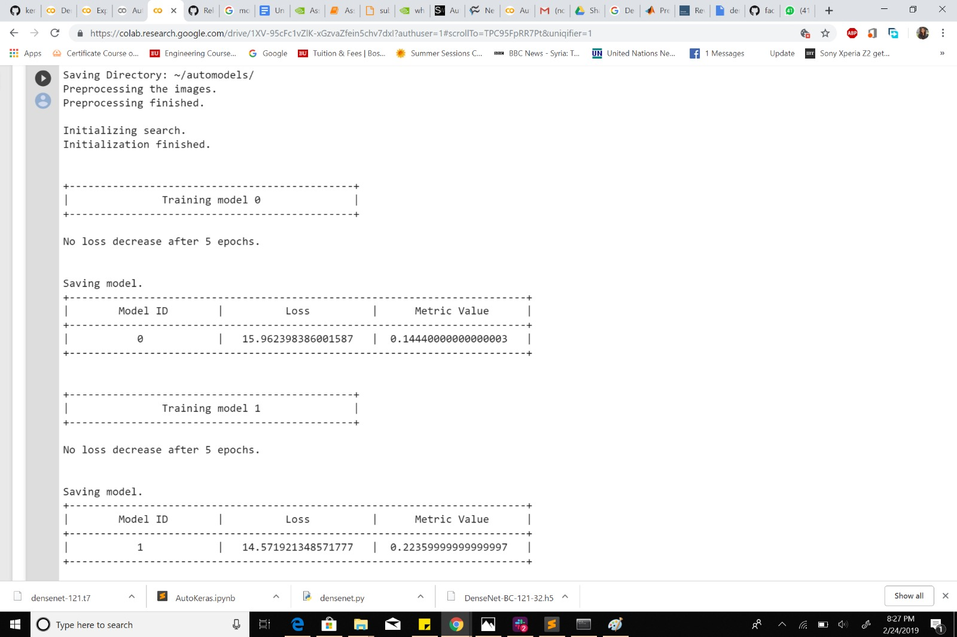
AUTO KERAS

Slide 7
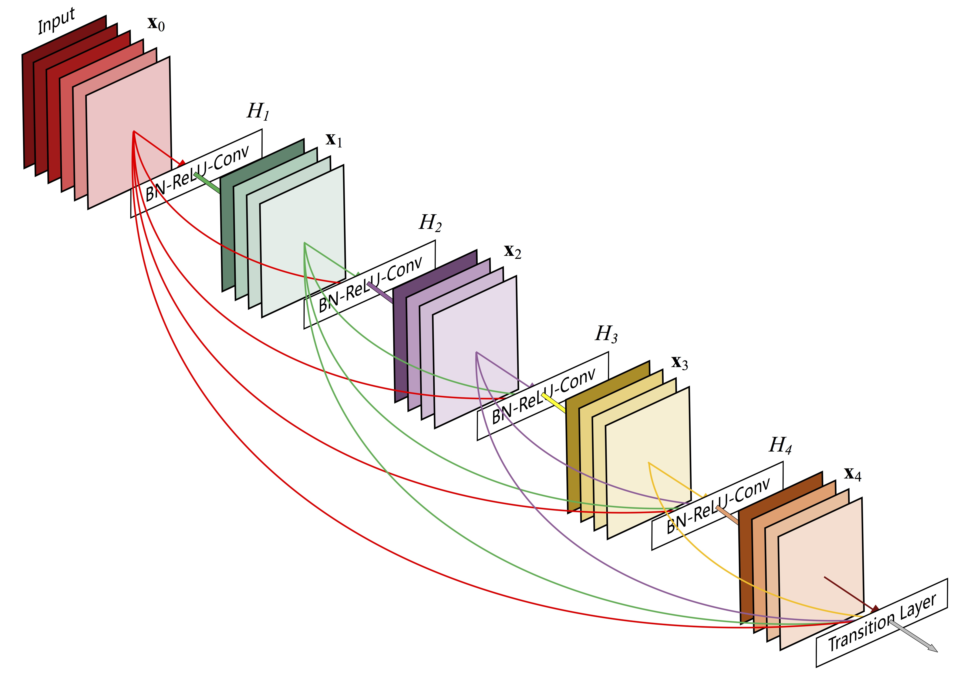
DENSENET201

Slide 8
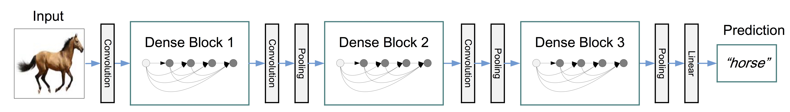
Model ID | ImageNet Acc (Top 1) | ImageNet Acc (Top 5) | Params (M)
DenseNet-121 | 25.02 % | 7.71 | 8.0
DenseNet-169 | 23.80 % | 6.85 % | 14.3
DenseNet-201 | 22.58 | 6.34 % | 20.2
DenseNet-161 | 22.20 % | - % | 28.9

Slide 9
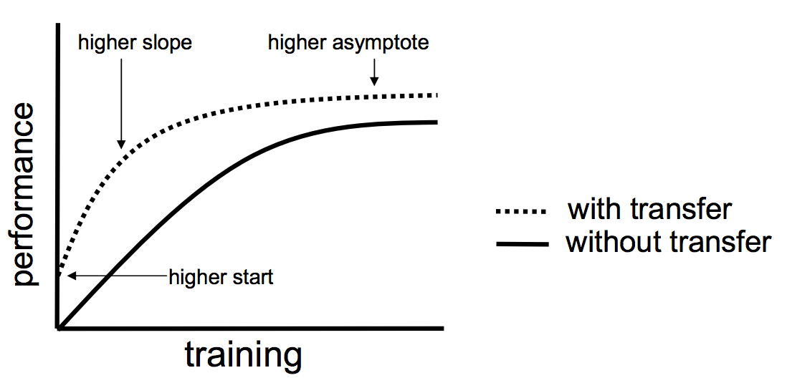
TRANSFER LEARNING
Transfer learning is a machine learning technique where a model trained on one task is re-purposed on a second related task

Slide 10
FINE TUNING
The task of fine-tuning a network is to tweak the parameters of an already trained network so that it adapts to the new task at hand.
The initial layers learn very general features and as we go higher up the network, the layers tend to learn patterns more specific to the task it is being trained on.
Thus, for fine-tuning, we keep the initial layers intact and retrain the later layers of the model.

Slide 11


Based on the above model, by using pre-trained features, the accuracy of the model jumped from 93% to 80.50% on the test data after applying the DenseNet201 network.
Also, the number of trainable parameters in the transfer model is low as compared to scratch model. Apart from this, the CNN scratch model took around 15 minutes to train on CPU, while the transfer model took less than a minute to train the model.
We can conclude that the use of Fine Tuning not only improves the performance of the model but also is computationally efficient.

